Slide 1
User interface design

Slide 2
UI : Week 6, Monday
Dr. Jillian Aurisano
This week: More human-centered design
New sketching methods today
Ethical human studies research, Interviewing/Focus Groups in depth, Thematic Analysis, Coding
Observation- Friday – this one only works in person
Next week- stuff about people- how we see, how we think…
Notes:
So welcome to engineering visual interfaces for data science. I'm Dr Aurisano.
Thanks for finding the class on Zoom. Hopefully we will be in person again soon.
If anyone out there is comfortable turning on their cameras, that is lovely- then I feel like I am talking to students, rather than to myself.
Here’s our plan for today:
First I’m going to introduce myself, so you know a bit about me
Then we are going to get to know each other, in Zoom breakout rooms. This will give us a chance to make sure that Zoom breakout rooms work, and we all know how to access them.
Then, I am going to walk through the structure, and plan for the course. I want to make sure everyone knows how the course will work, and what to expect, and also a bit about why the course is designed this way.
Then I am going to introduce the class, and what the class is about. Since this is a new class, and one of just a few classes in human centered computing here at UC, I wanted to give an overview of the topic.
Then I have an introductory activity, which we will do in breakout rooms, and which I think will help motivate the discussion on Wednesday, and getting into the meat of the class.

Slide 3
Collaborative dev for a course project
Git and teams- Recommendation:
Make a branch for a stable version
Make a branch for yourself or the new feature you are working on
Finish your feature
Tell your team you are going to merge
First: Merge the stable branch into your branch and make sure it all works
Then: Merge your branch- which includes your new feature and the stable branch- back into the stable branch
Tell your team you have updated the stable branch

Slide 4
Project 2
Objects?
Other questions?

Slide 5
Sketching
Sketching is a tool for visual thinking
Go from a general sense of what we want, a vague picture in our heads, to something we can see on paper
Sketches can be generated quickly and should be used to help work out design challenges, and test interface design choices
We have looked at:
Sketching to brainstorm
Sketching the interface elements
Today: Sketching storyboards

Slide 6
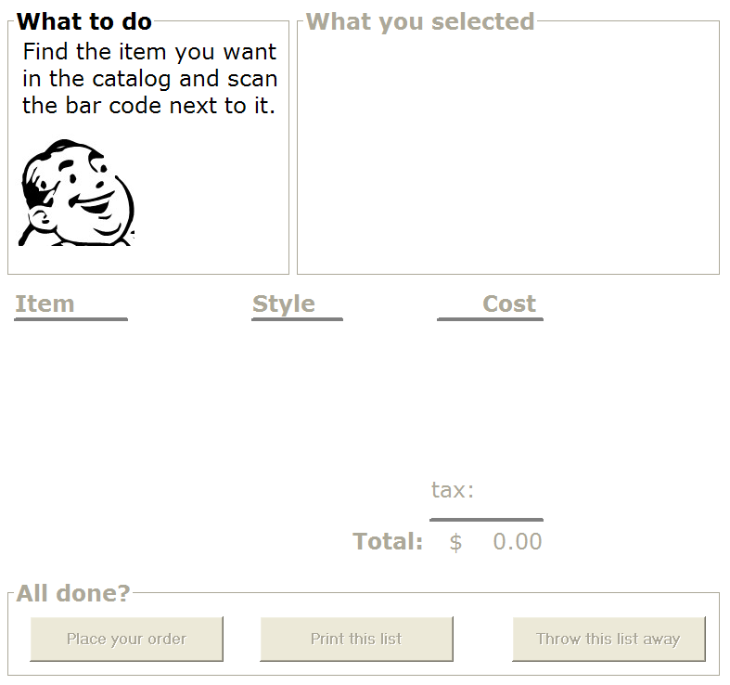
A single sketch
The interface at a single moment in time
Which helps us think about layout, composition, color, features…
But: can’t capture the full user experience
Experiences unfold over time!
Single sketches:
captures user interface, but not user behaviour
excludes dynamics of interaction over time
user actions
system responses
context
doesn’t tell a story
We need methods for visual storytelling

Slide 7
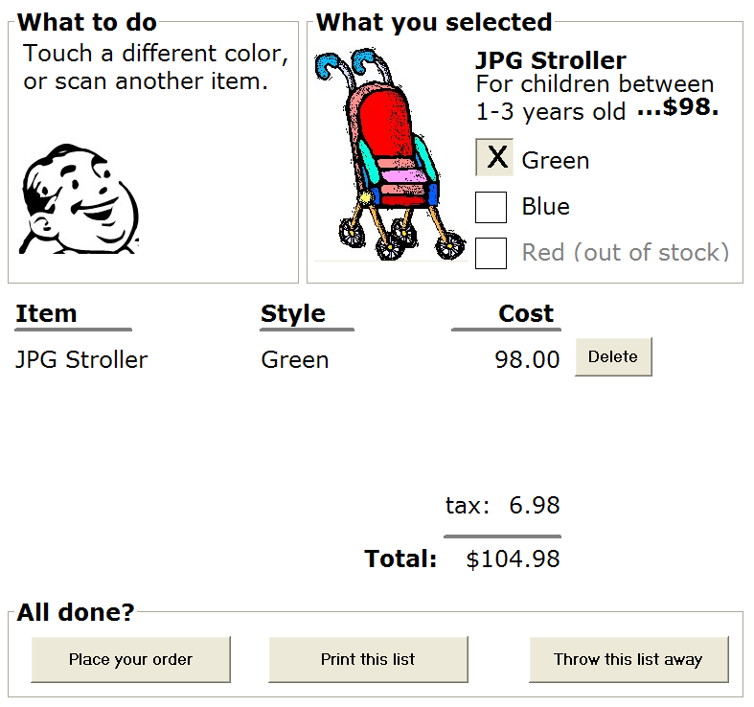

Sequential storyboards
Basic storyboard is a visual narrative
Each image shows interface snapshots at points in the interaction
Key frame, or state at one moment in time
Portrays
key scenes in the interface
transitions that caused the changes

Slide 8
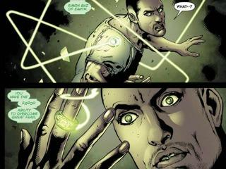
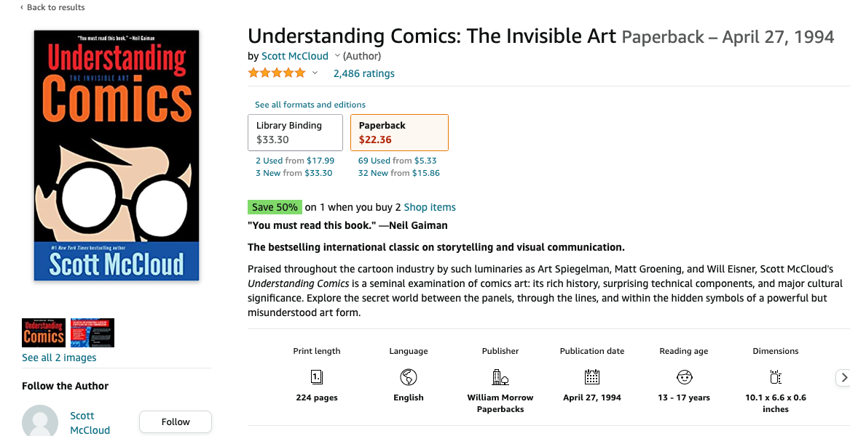
A Long Tradition – Comics
How to convey a narrative through sequences of images, text and gaps between images (transitions)
Image from: Creative Commons DC Comics: http://www.ntn24.com/news/news/muslim-arab-american-green-lan-16964,

Slide 9
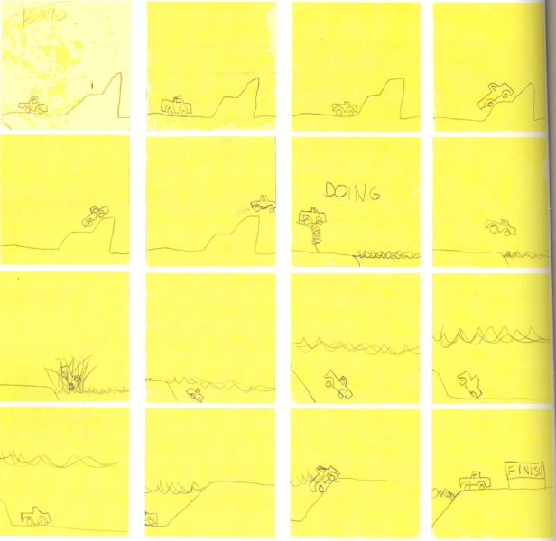
A Long Tradition – Animation
Consider this simple flipbook animation with post-its
Bill Buxton Sketching User Experiences, Morgan Kaufman Figure 107

Slide 10
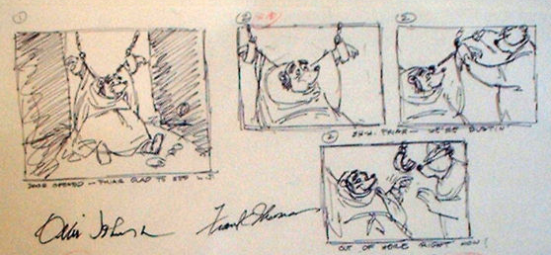
A Long Tradition – Animation
Before creating the animation
Sketching the sequence of events
Note the gaps here- this couldn’t be an animation
But it is key moments in this sequence
Image from: Disney’s Robin Hood storyboard, www.animaart.com/Cellar/disneyart/90robin%20storyboard.jpg.html

Slide 11
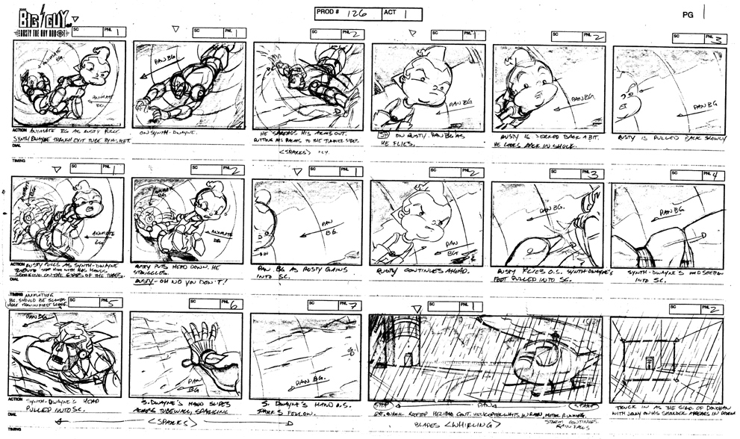
A Long Tradition – Animation
From sequences of images to explore stories, to complete storyboards
Include annotations and structure
Descriptions of what happens in each frame
Storyboards help animators create the final images that makeup the animation
Image from: www.michaelborkowski.com/storyboards/images/big_bigguy1.gif

Slide 12
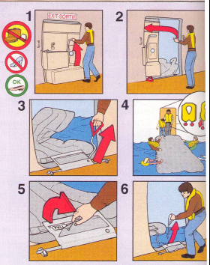
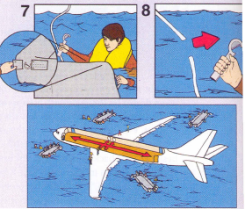
Other sequential stories: step-by-step guides
Annotations to show actions, and outcomes
Pull here, and then this will happen…
Image from:

Slide 13
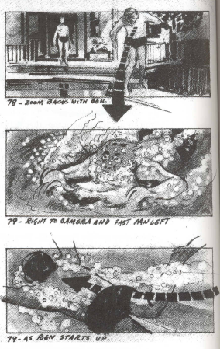
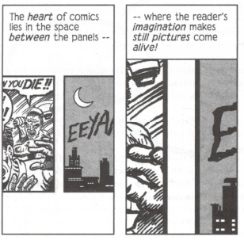
Key Elements: Transitions
Our brain fills in these gaps
Between one static image and another
Image from: Understanding Comics. Harper Collins (reproduced in Buxton, Sketching the User Interface)

Slide 14
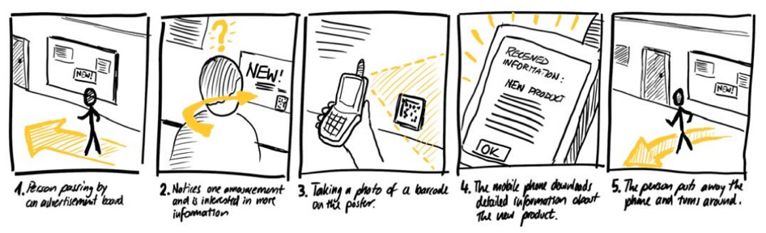
Note the frames shown. The annotations. The transitions.

Slide 15
Exercise
Your cell phone
With a partner, create a storyboard of only images (no annotations for now) that
capture your phone’s interaction over time as
you enter a new name and number into the phone’s contact list

Slide 16
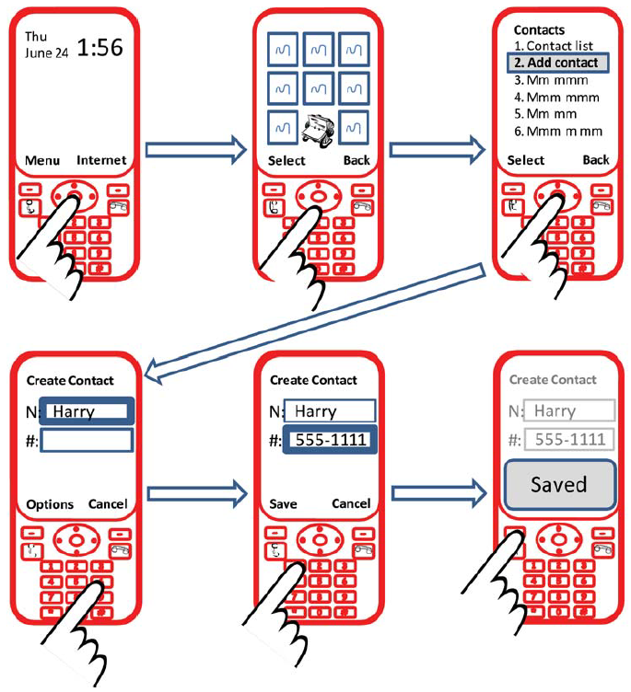
One approach….

Slide 17
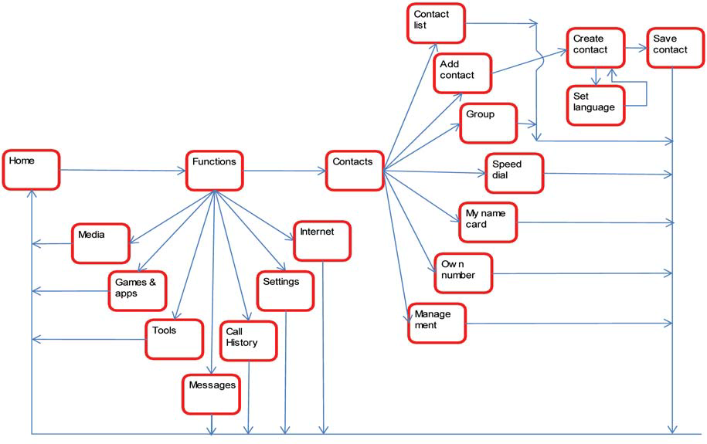
The Abstract Branching Diagram
Fit lots of transitions and states

Slide 18
Key decisions
Should I show the user in the scene or just the phone UI?
What key frames should I use to create the sequence?
Enough to capture the essence of the story
Assume people can ‘fill in’ the rest - the gaps
What key transitions should I show?
actions to get from one frame to the next?
Bill Buxton Sketching User Experiences, Morgan Kaufman Figure 4

Slide 19
Key Decisions
How explicit and detailed do you need to be?
Depends on what you are trying to explain
are the missing parts important?
Depends on the audience
can your audience fill in the missing bits?

Slide 20
Exercise
Annotate your previous storyboard
label your phone’s state underneath each image
label each transition to explain user’s action

Slide 21
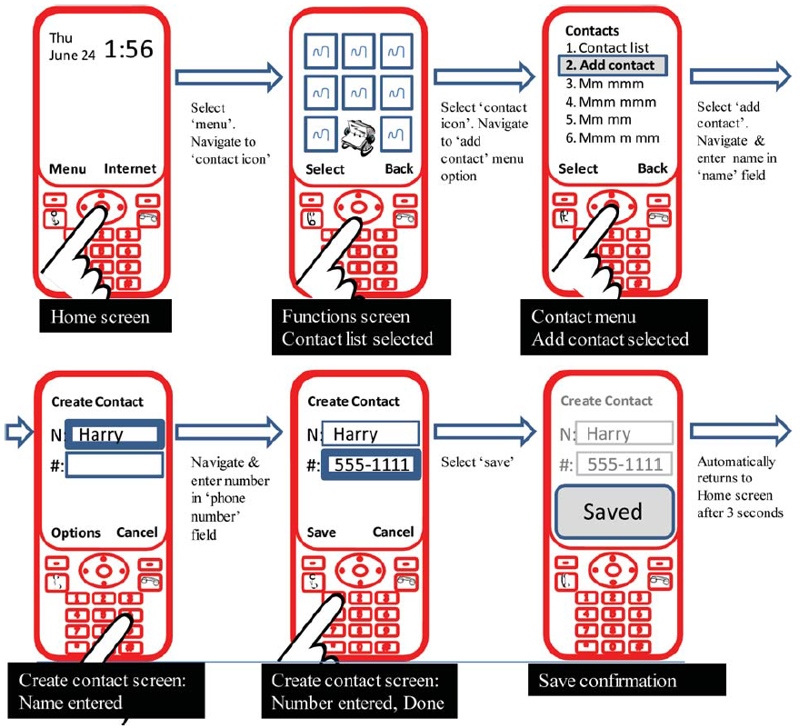
examples

Slide 22
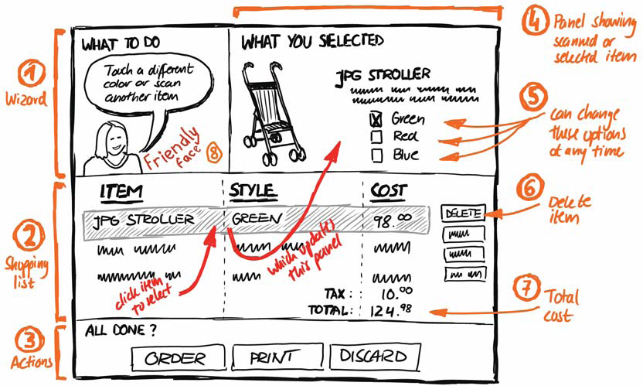
As a single sketch example
How might we explore this deeper with a storyboard?

Slide 23
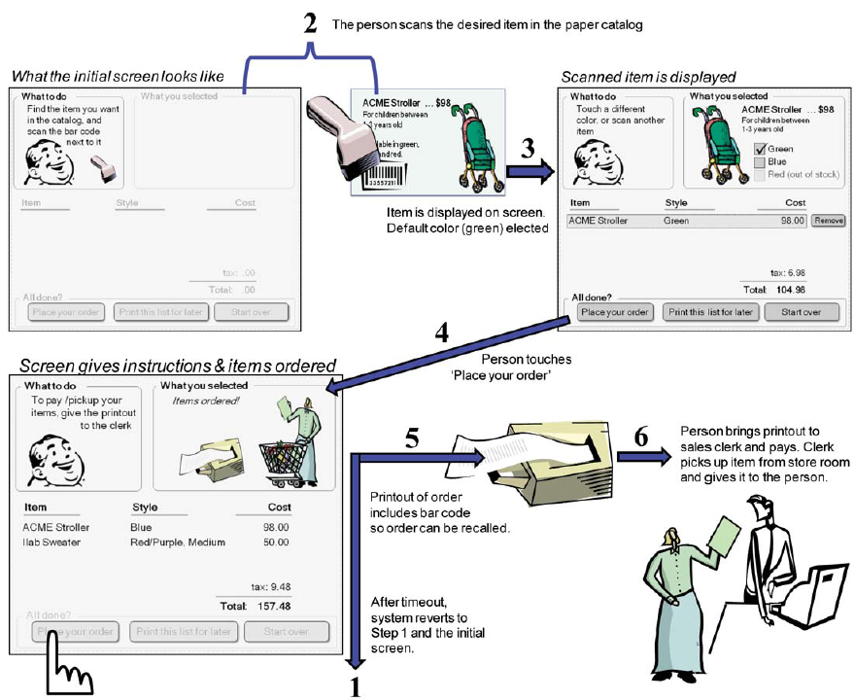

Slide 24
Recap
Sequential storyboard
a visual story of the user experience over time
Composed of
key frames
annotations

Slide 25
In class activity
First: Open a maps application on your phone or computer (your choice)
Pick a task- (e.g., find a coffee shop, open until 8pm, near campus)
Identify the sequence of actions you may perform to accomplish this task
Draw one storyboard for the sequence of actions you have described above
What key frames should I use to create the sequence?
capture the essence of the story
people can ‘fill in’ the rest
What key transitions should I show?
actions to get from one frame to the next?
This can be a quick sketch, for in-class time

Slide 26
In class activity 2- integrating actions in the world
First: Sketch a storyboard for this action sequence:
Someone walks past a door with a posted QR code
The QR code links to a scheduling app
They scan the QR code
It opens to a schedule for the day
There is a button to request the room
This leads to a form where they input their desired time
When they enter this time, the app should tell them if they have successfully scheduled
This can be a quick sketch, for in-class time

Slide 27
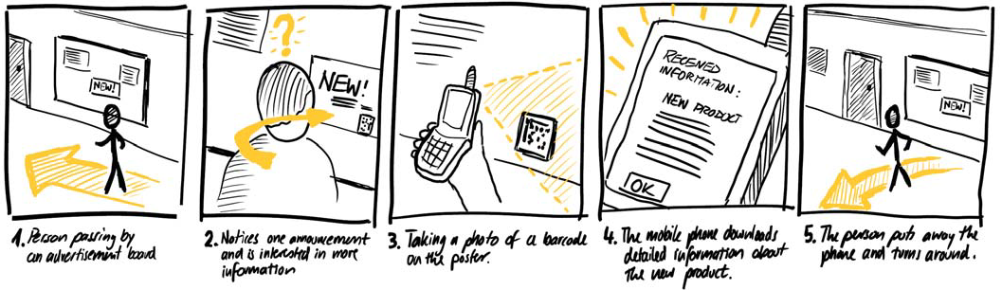
Narrative sketching
Capture the user, the device, the context, the UI, the world, in a sequence of sketches

Slide 28
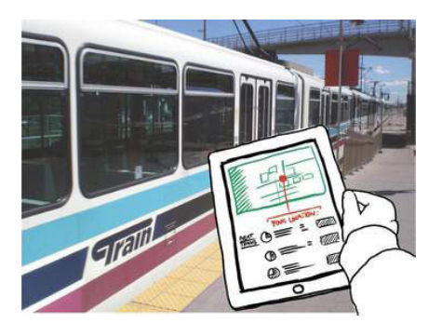
Hybrid sketches
1. Take a photo, from the point of view of the user
2. Sketch- using paper, a digital tool
3. Integrate the two

Slide 29
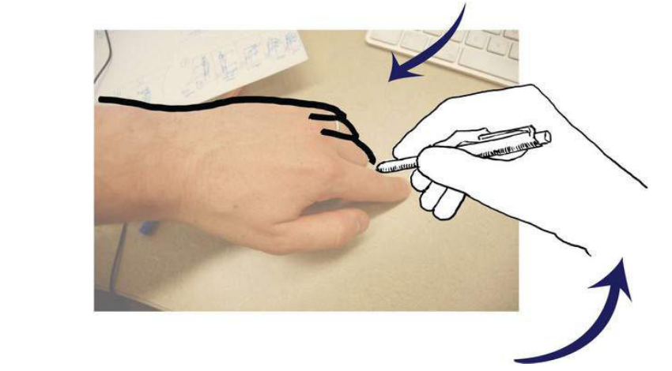
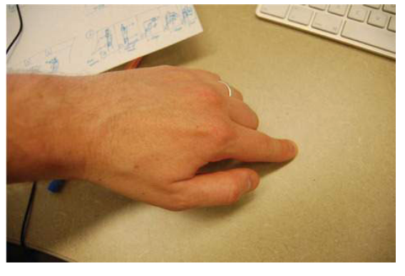
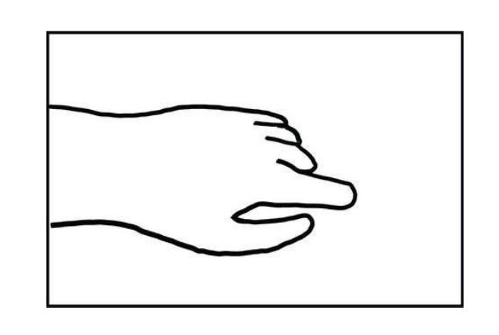
Photo traces
You can create sketches with realism using a photo tracing technique

Slide 30
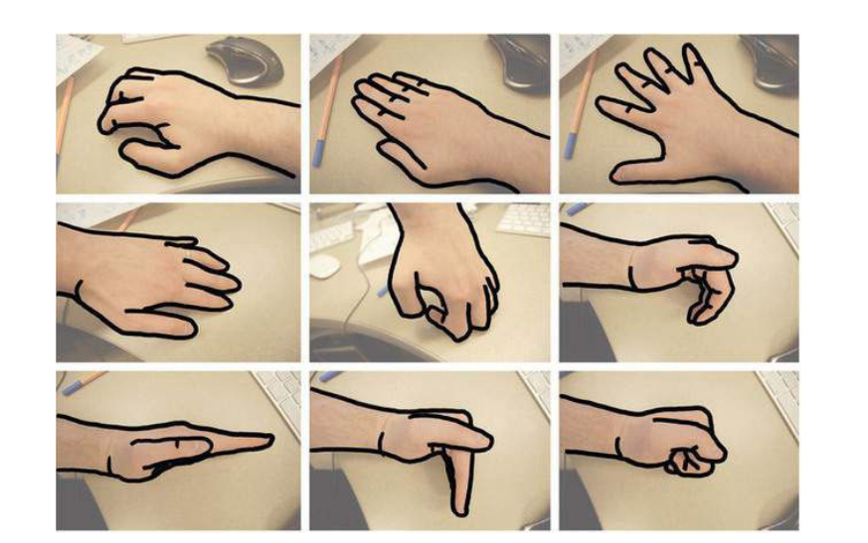
Photo traces example

Slide 31
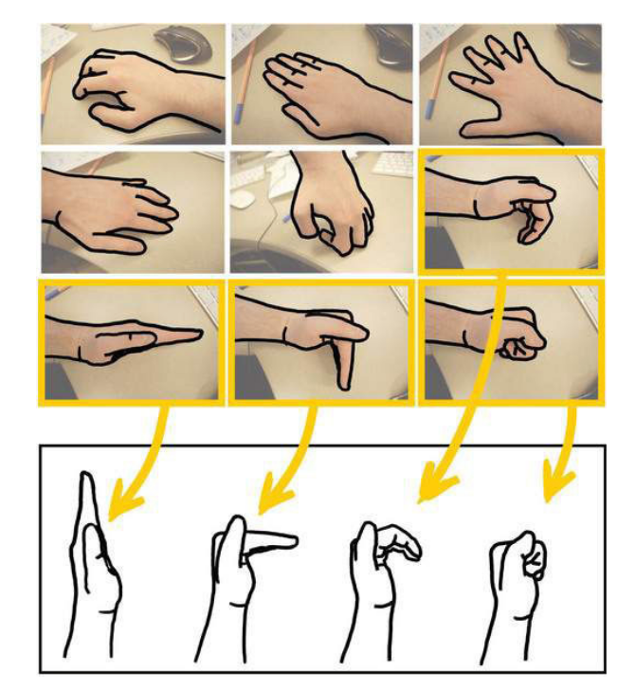
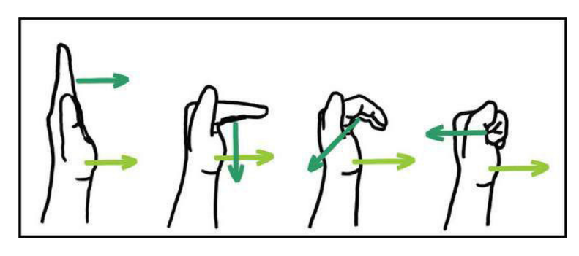
Photo traces of gestures

Slide 32
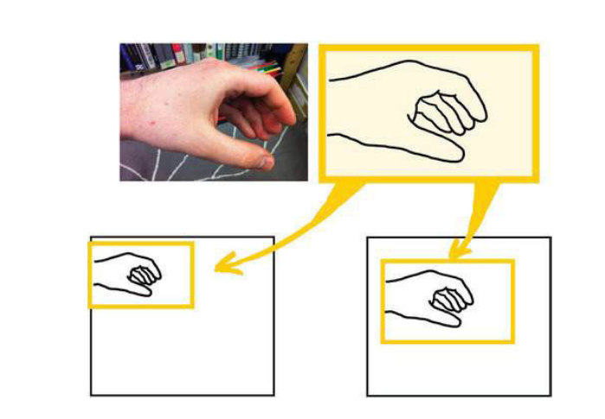
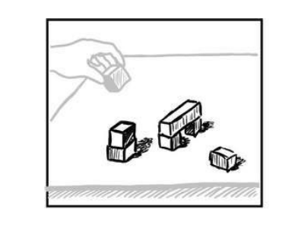
Photo traces to interact with objects

Slide 33
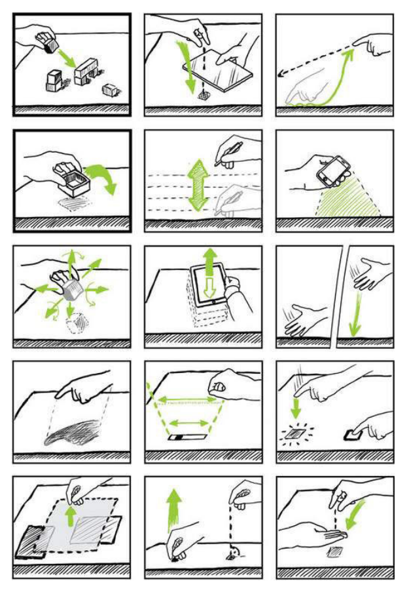
Photo traces interactions

Slide 34
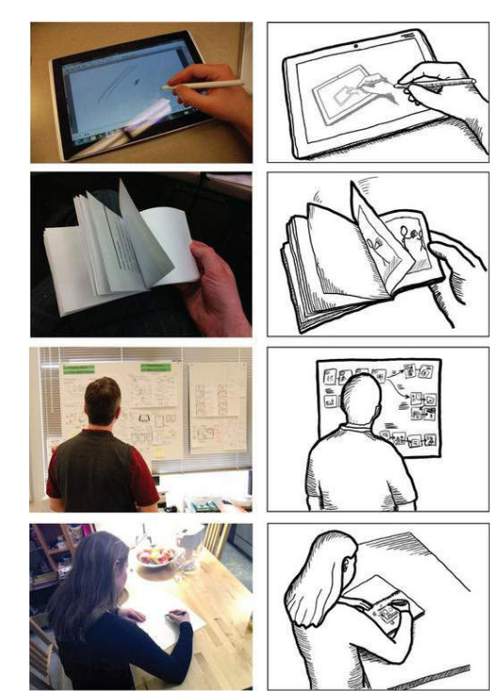
Photo traces including people and devices

Slide 35
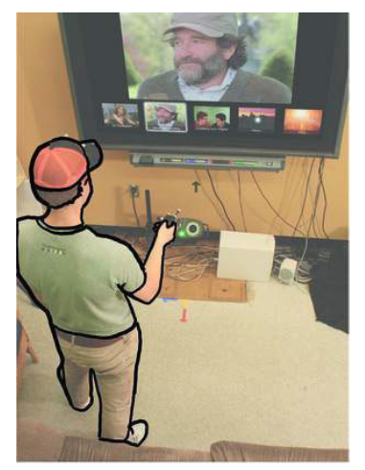
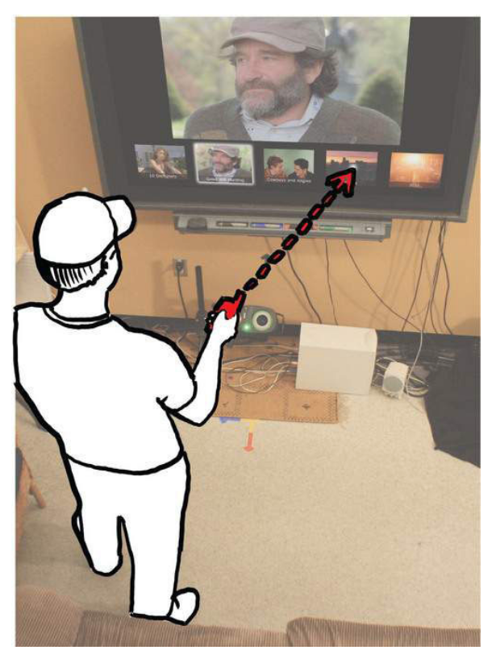
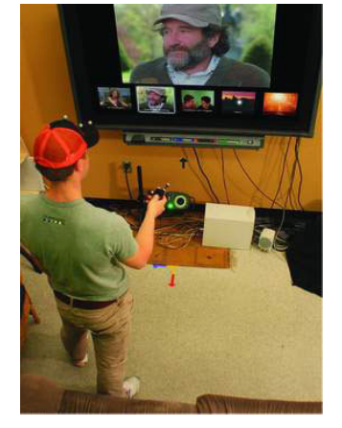
Hybrid sketching with photo traces

Slide 36
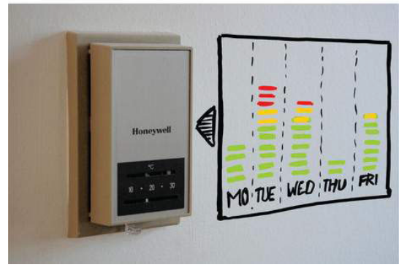
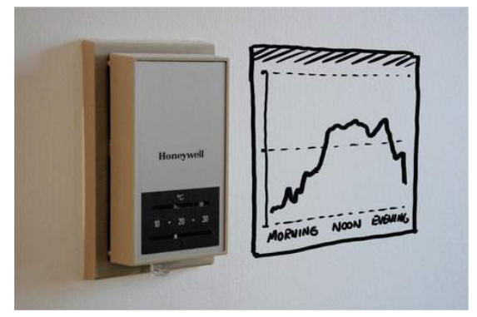
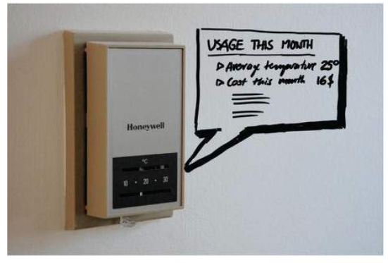
Augmented reality thermostat

Slide 37
These slides are adapted from:
Sketching user experiences, the workbook
https://sketchbook.cpsc.ucalgary.ca/?page_id=64

